Slide 1
Modeling and simulation of a communication system for Distribution Power System -Case Study University Campus
Jesus Eduardo Ortiz Sandoval
PhD Student

Slide 2
Content
Motivation
Problem definition
Modeling and simulation DAS
Case of Study- Simulation network
Conclusions
References

Slide 3
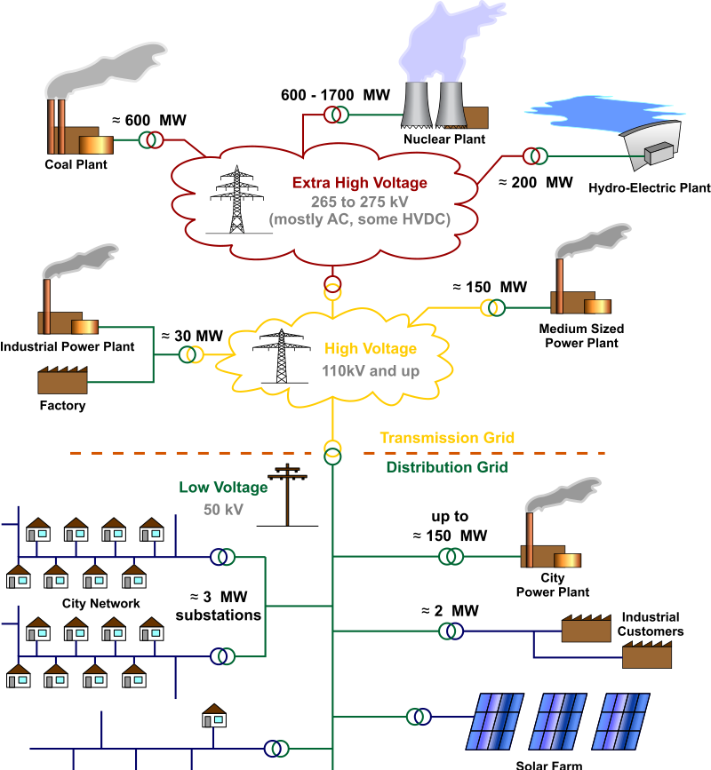
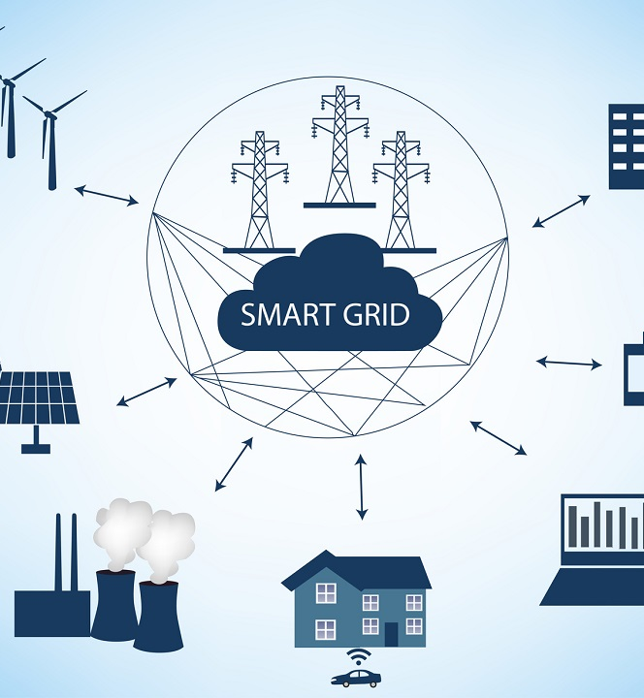


Slide 4

And, what is the main problem?
One of the main objectives to build the new smart cities is to implement new technologies in all communication layers, in our case we will implement a topology that allows us to operate and monitor the distribution system for EV with a few requirements in this approach.

Slide 5

Requirements
Budget (It’s important)
Eficiently
Fast
Innovative!!!
Smart, for Smart Grid

Slide 6
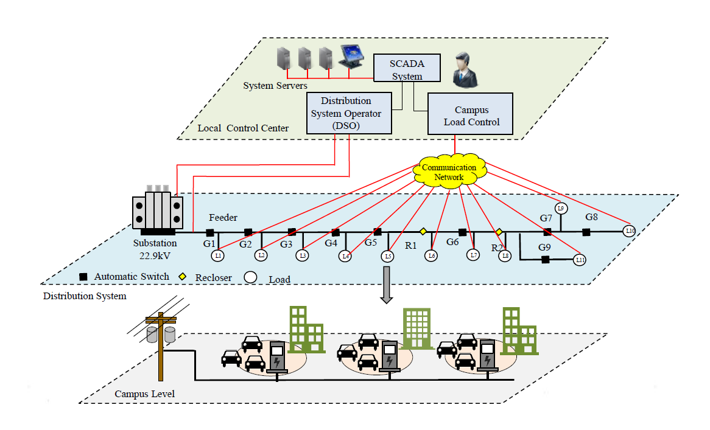

Slide 7
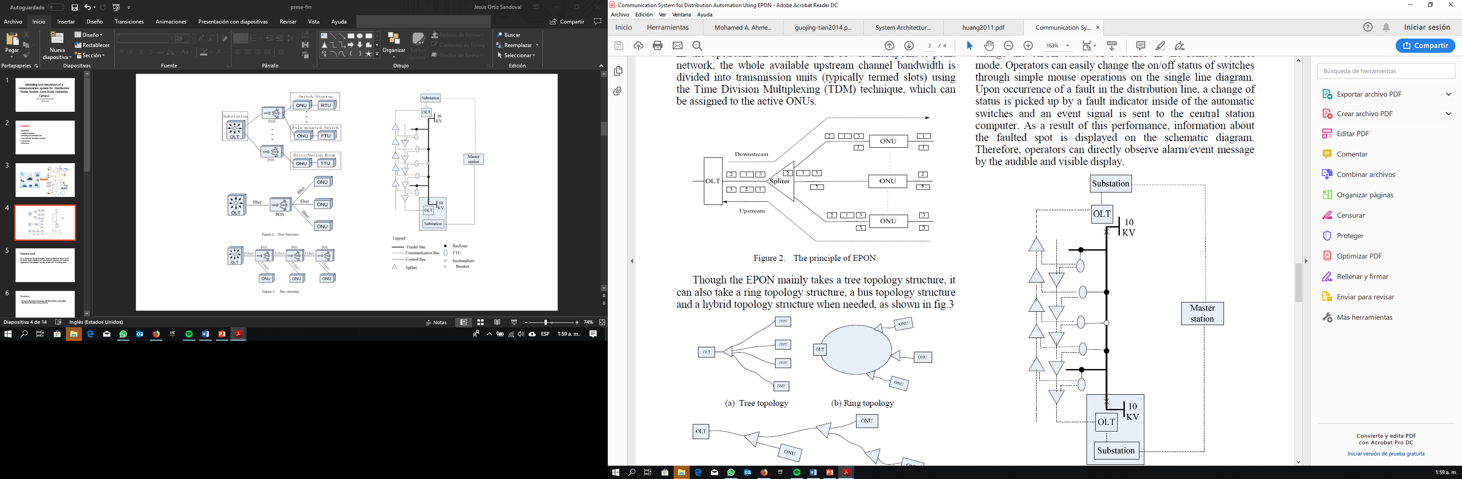
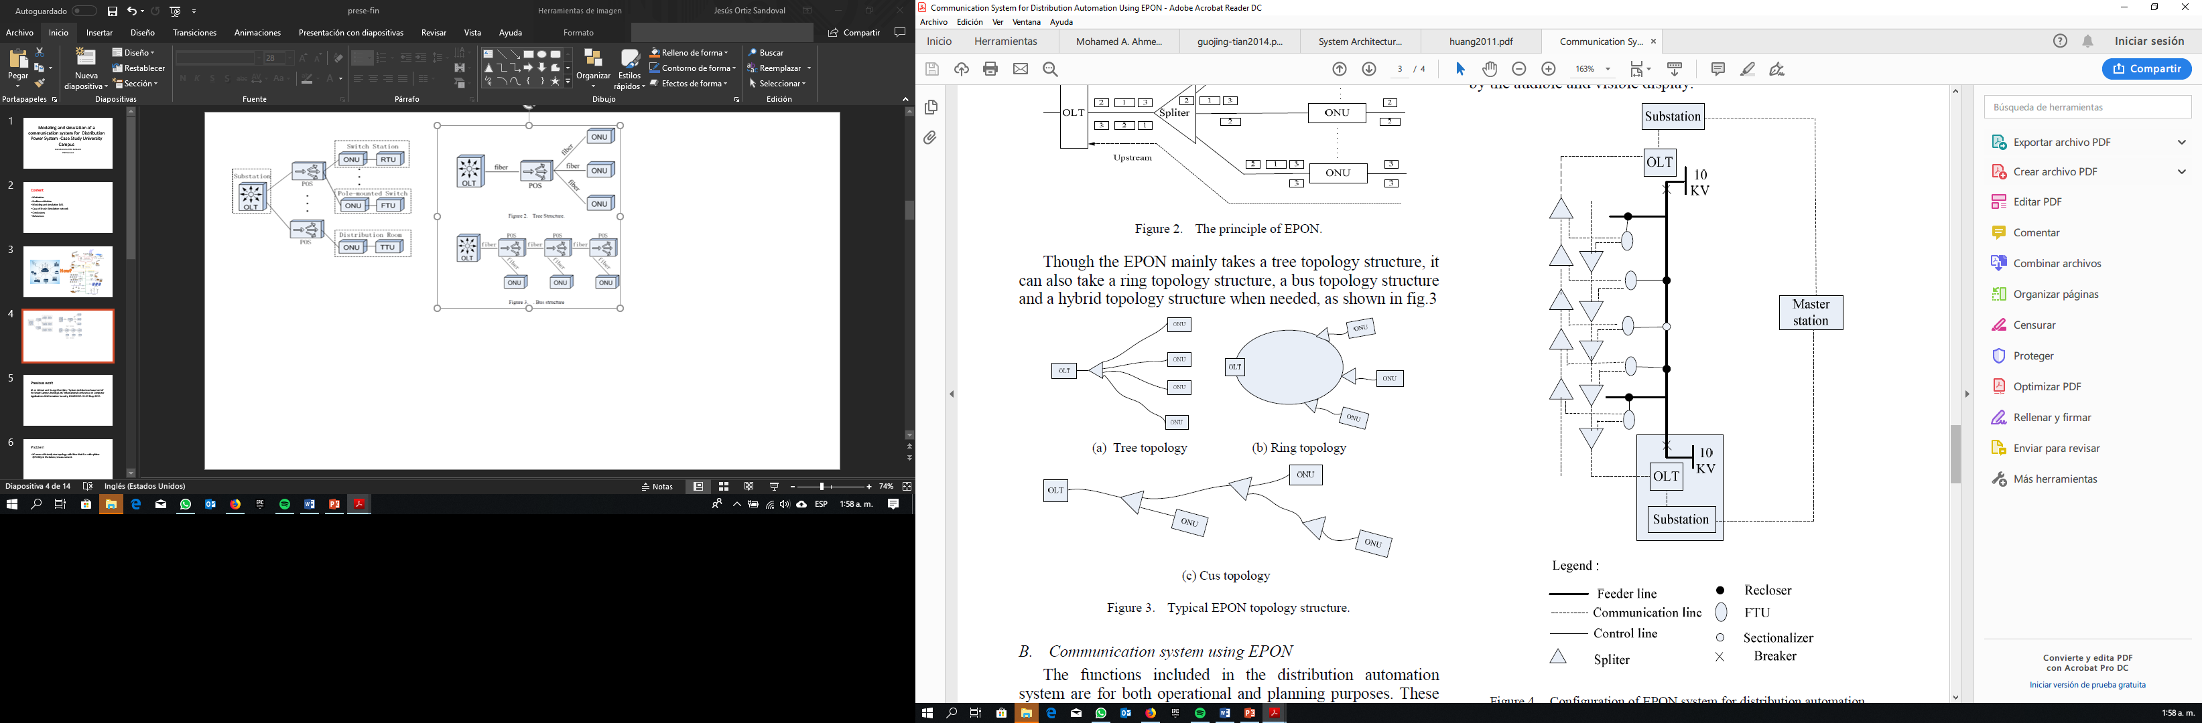
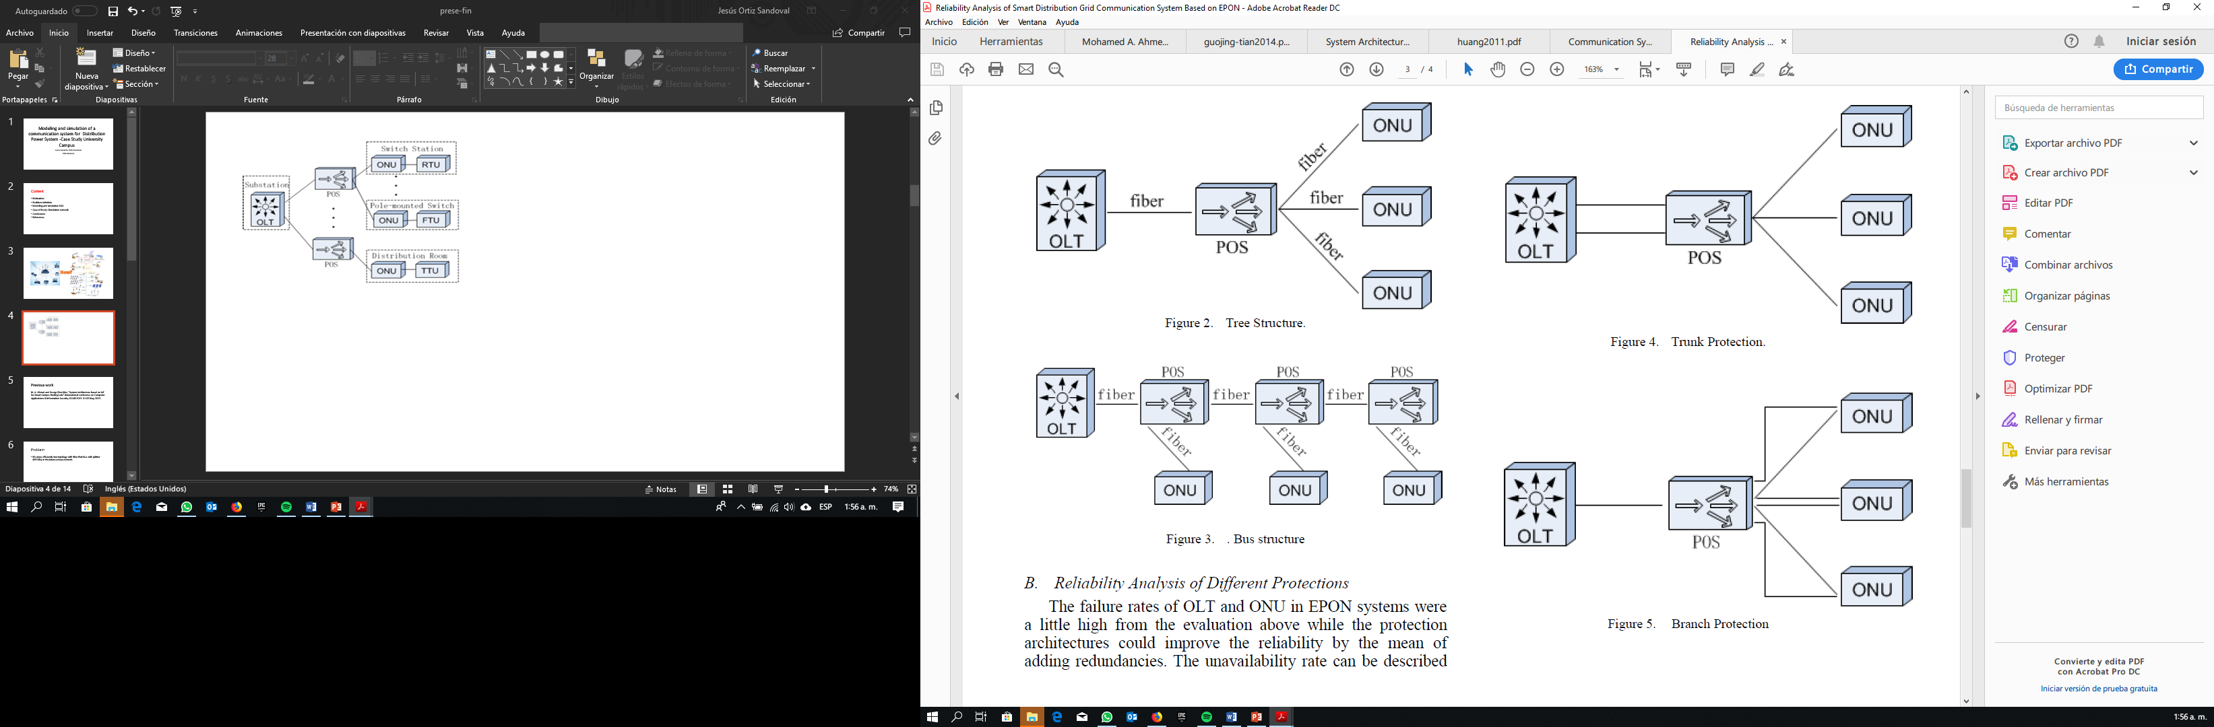
EPON

Slide 8
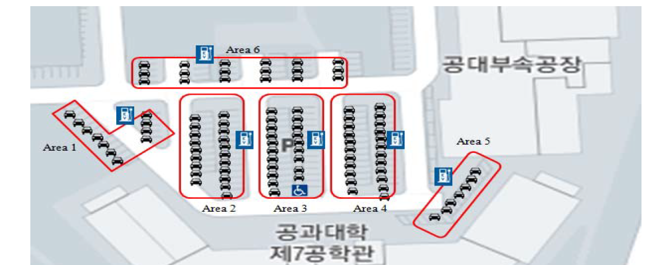
Chonbuk National University, South Korea {1}

Slide 9
Model
COMPONENT | Attenuation | Insertion Loss
Fiber | 0.4 dB/Km | N/A
Connector | 0.2 dB | N/A
Splitter 1x2 | N/A | (5%-95%) (0.4dB -11dB)
Splitter 1x4 | N/A | (25%-25%-25%-25%)(6dB-6dB-6dB-6dB-)

Slide 10
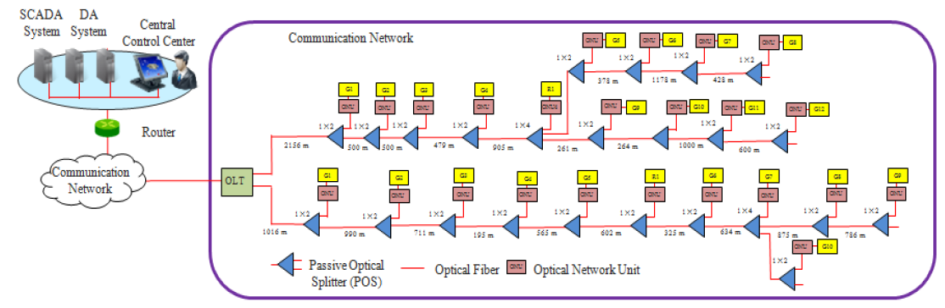


Slide 11
ONU | Fiber Loss | Splitter Loss | Connector Loss | Total Loss
G1 | 0.4064 | 11 | 0.6 | 12,0064
G2 | 0.8024 | 11.4 | 1.0 | 13,2024
G3 | 1.0868 | 11.8 | 1.4 | 14,2868
G4 | 1.1648 | 12.2 | 1.8 | 15,1648
G5 | 1.3908 | 12.6 | 2.2 | 16,1908
R1 | 1.6316 | 13 | 2.6 | 17,2316
G6 | 1.7616 | 8 | 3 | 12,7616
G7 | 2.0152 | 19 | 3.4 | 24,4152
G8 | 2.3652 | 19.4 | 3.8 | 25,5652
G9 | 2.6796 | 19.8 | 4.2 | 26,6796
G10 | 2.0152 | 20.2 | 4.6 | 26,8152
ONU | Fiber Loss | Splitter Loss | Connector Loss | Total Loss
G1 | 0.4064 | 0,4 | 0.6 | 1,4064
G2 | 0.8024 | 0,8 | 1.0 | 2,6024
G3 | 1.0868 | 1,2 | 1.4 | 3,6868
G4 | 1.1648 | 1,6 | 1.8 | 4,5648
G5 | 1.3908 | 2 | 2.2 | 5,5908
R1 | 1.6316 | 2,4 | 2.6 | 6,6316
G6 | 1.7616 | 2,8 | 3 | 7,5616
G7 | 2.0152 | 8,8 | 3.4 | 14,2152
G8 | 2.3652 | 9,2 | 3.8 | 15,3652
G9 | 2.6796 | 9,6 | 4.2 | 16,4796
G10 | 2.0152 | 8,8 | 4.6 | 14,2152

Slide 12
Go to the software!!

Slide 13
ONU | Measurement 1 | Error | Measurement 2 | Error
G1 | 14,016 | -2,0096 | 1,029 | 0,3774
G2 | 15,035 | -1,8326 | 2,048 | 0,5544
G3 | 15,943 | -1,6562 | 2,955 | 0,7318
G4 | 16,643 | -1,4782 | 3,656 | 0,9088
G5 | 17,492 | -1,3012 | 4,505 | 1,0858
R1 | 18,356 | -1,1244 | 5,368 | 1,2636
G6 | 19,108 | -0,9464 | 6,121 | 1,4406
G7 | 12,995 | 0,8202 | 12,543 | 1,6722
G8 | 26,755 | -1,1898 | 13,768 | 1,5972
G9 | 27,693 | -1,0134 | 14,705 | 1,7746
G10 | 12,995 | 0,8202 | 12,543 | 1,6722

Slide 14
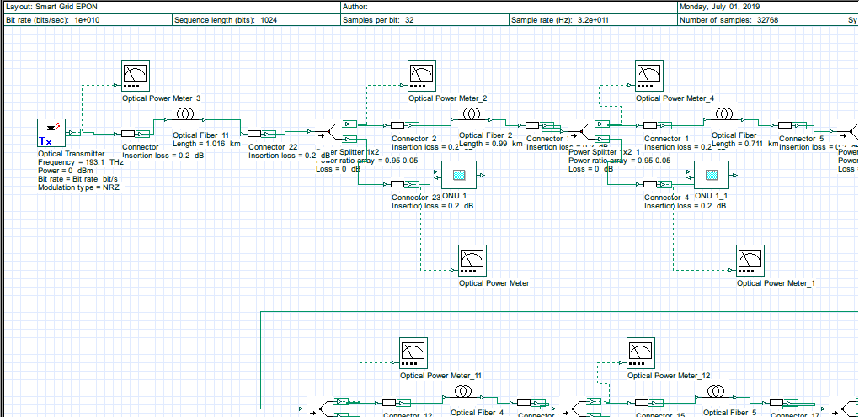

Slide 15
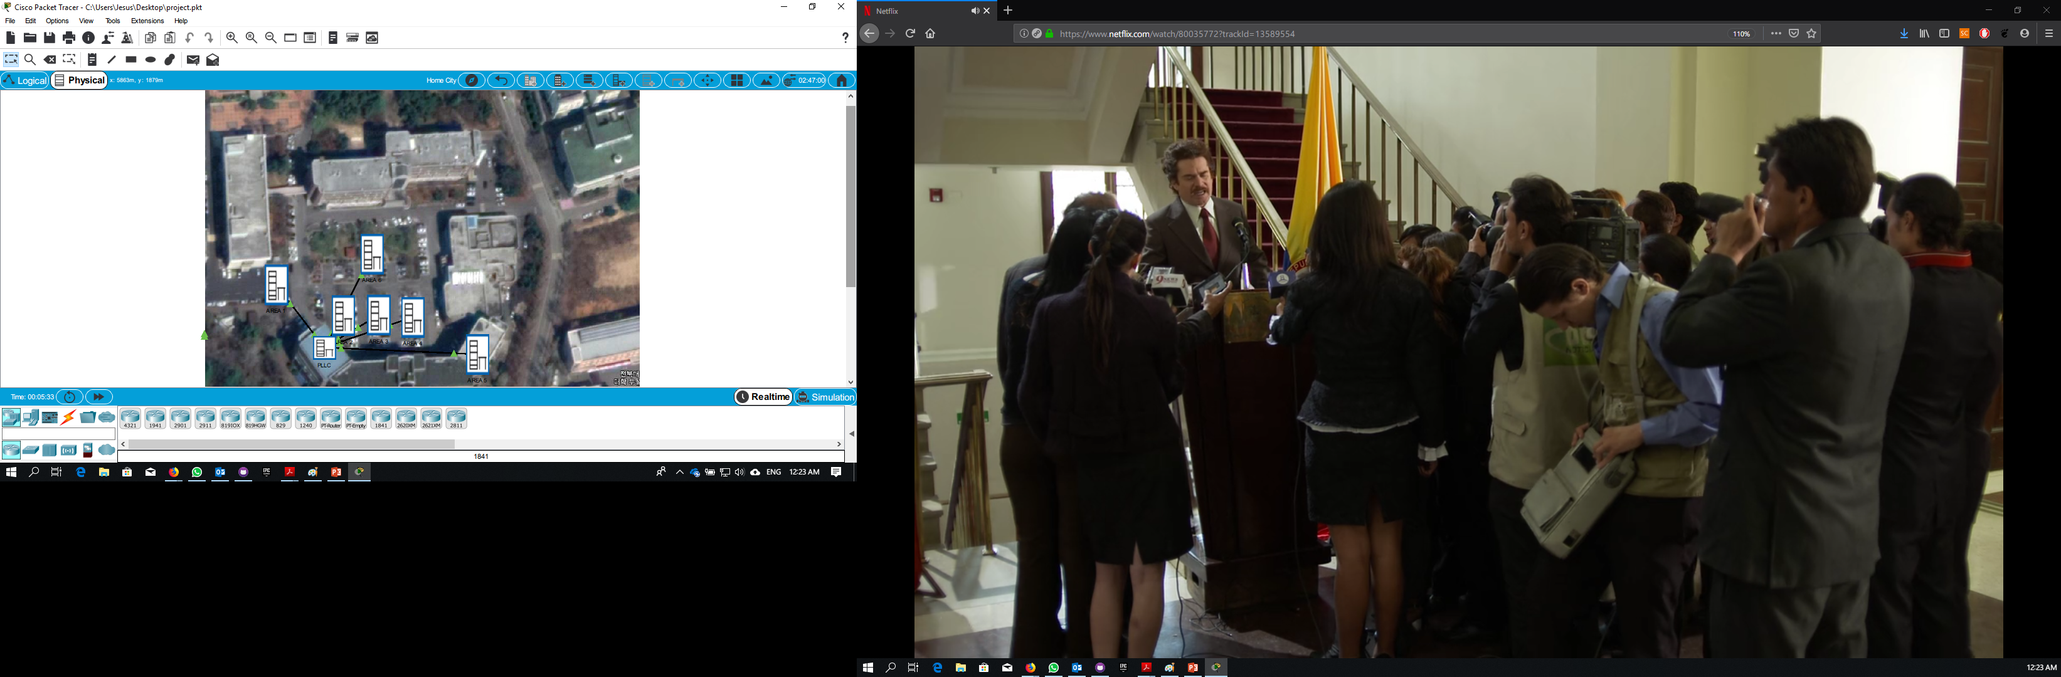
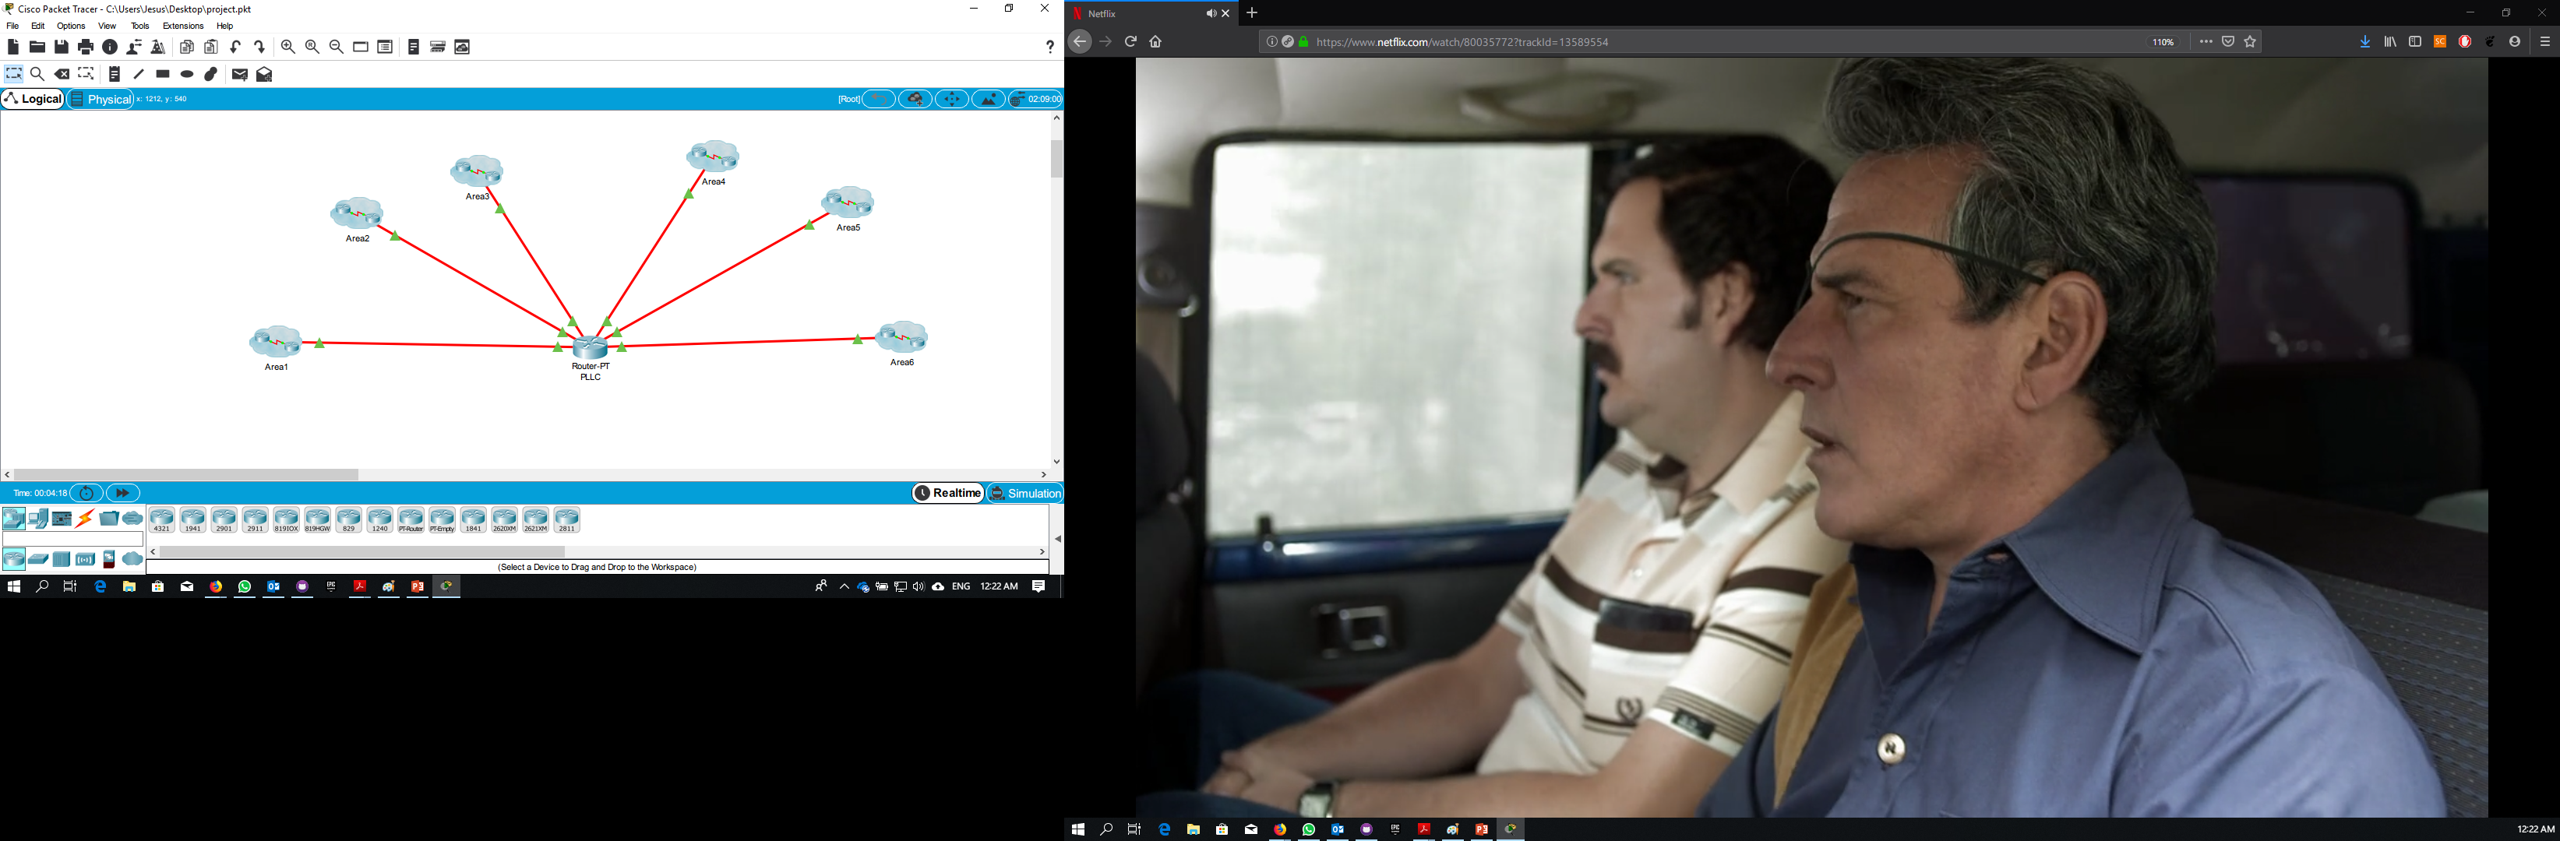
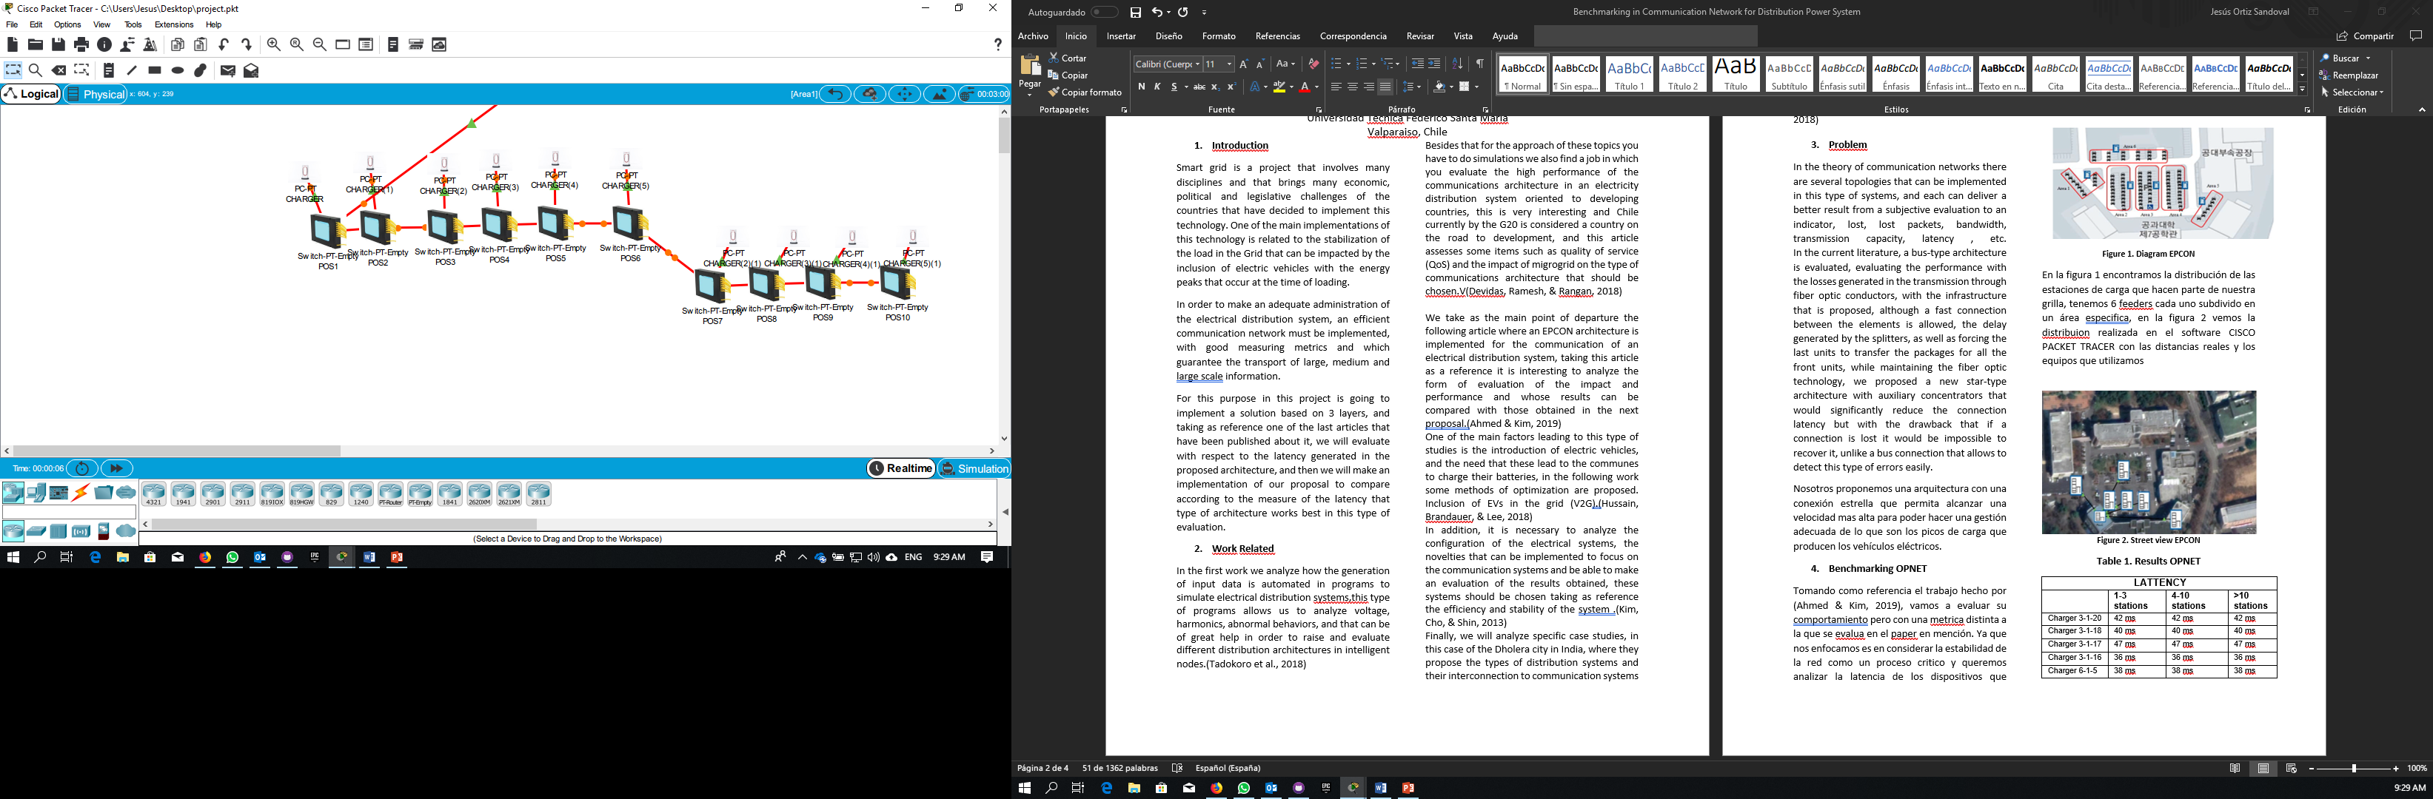

Slide 16
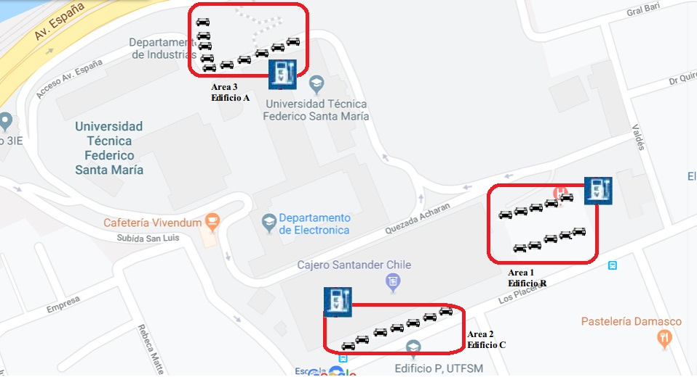
USM CAMPUS (PROPOSAL)

Slide 17
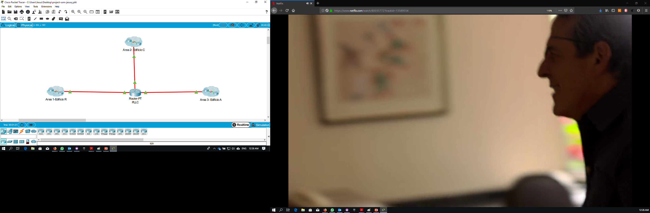
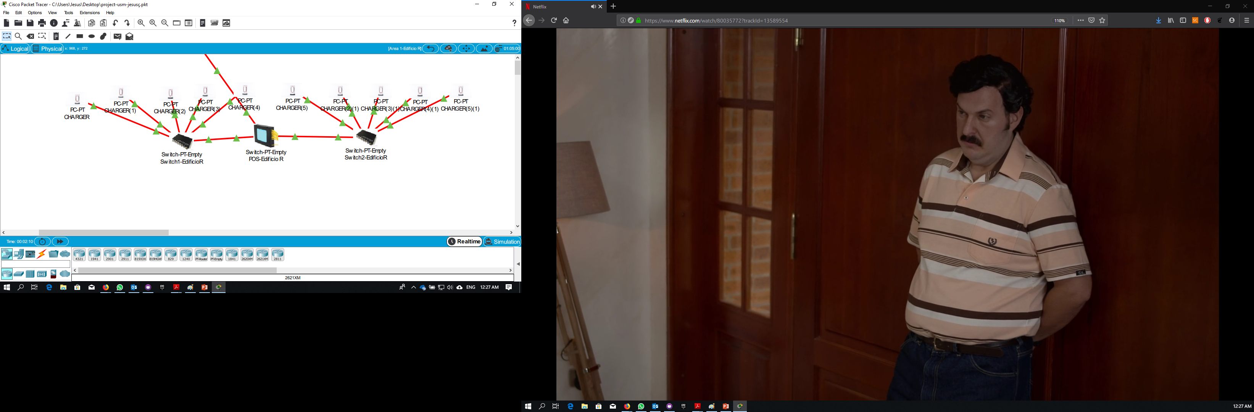

Slide 18
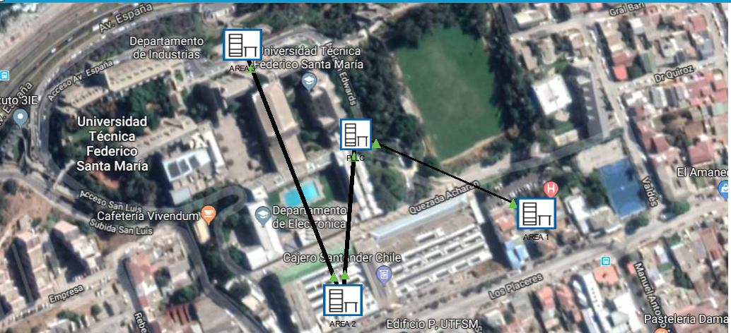

Slide 19
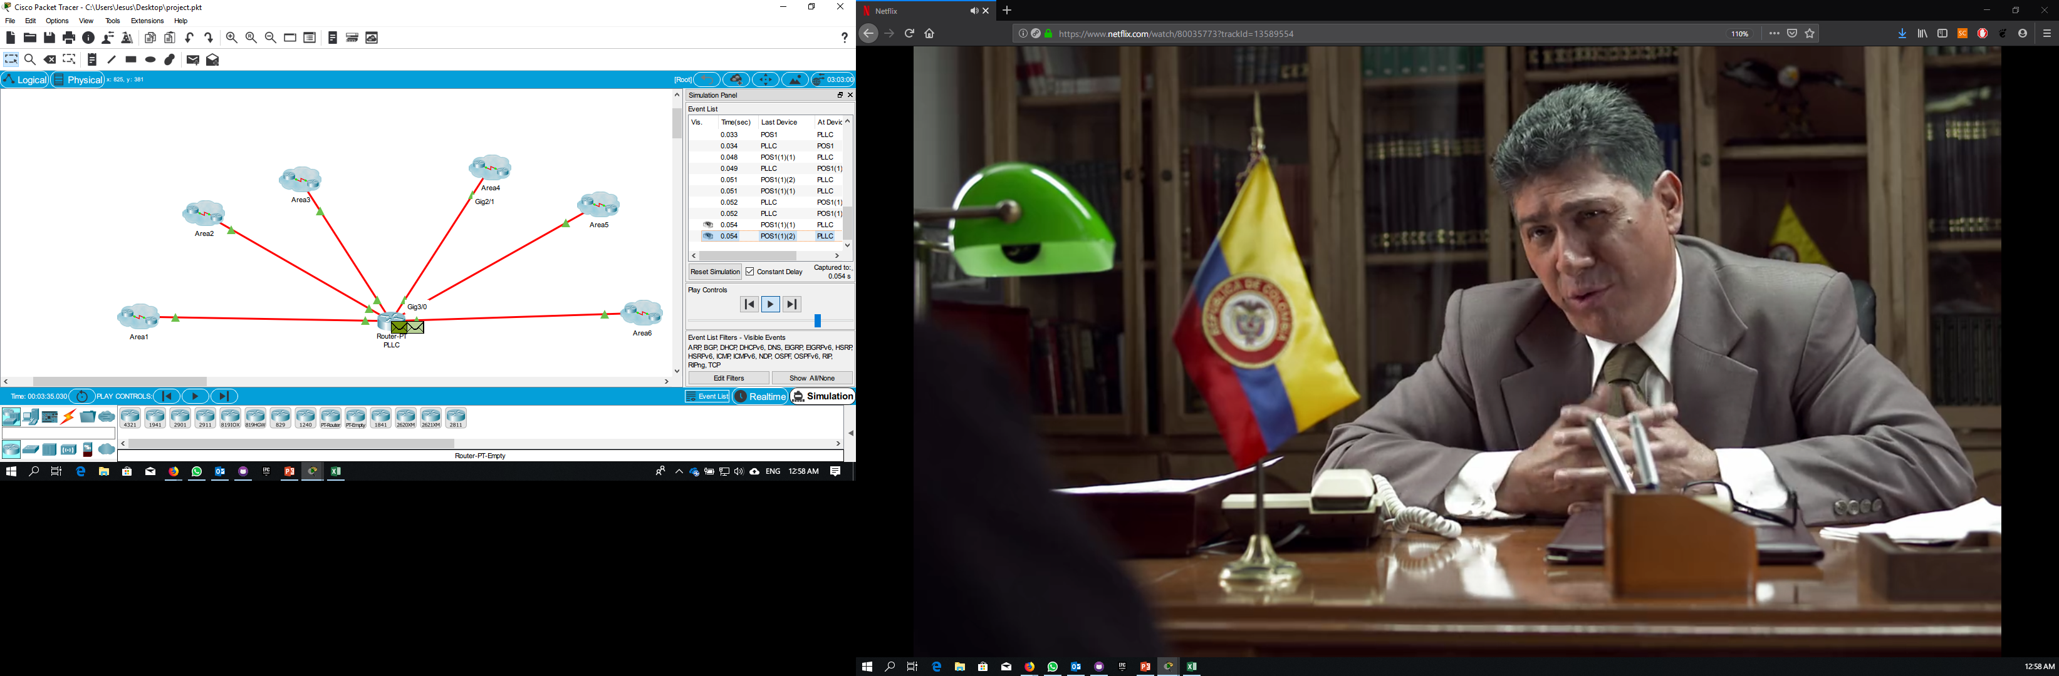
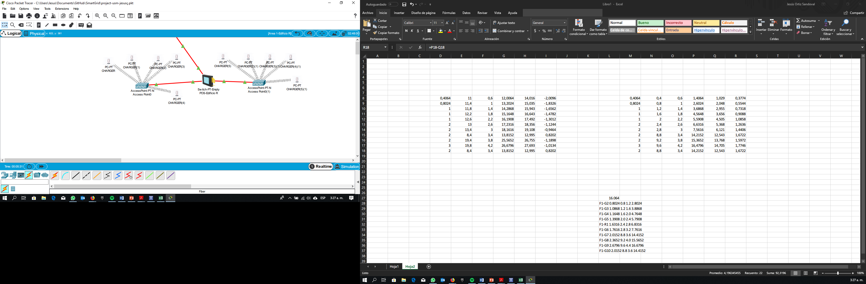
LATTENCY IDLE
 | 1-3 stations | 4-10 stations | >10 stations
Charger 3-1-20 | 42 ms | 42 ms | 42 ms
Charger 3-1-18 | 40 ms | 40 ms | 40 ms
Charger 3-1-17 | 47 ms | 47 ms | 47 ms
Charger 3-1-16 | 36 ms | 36 ms | 36 ms
Charger 6-1-5 | 38 ms | 38 ms | 38 ms
Charger 5-1 | 22 ms | 22 ms | 22 ms
Charger 6-1-15 | 36ms | 36ms | 36ms
Charger 4-1-7 | 34 ms | 34 ms | 34 ms
LATTENCY CHARGING WIFI
 | 1-3 stations | 4-10 stations | >10 stations
Charger 3-1-20 | 102 ms | 102 ms | 102 ms
Charger 3-1-18 | 90 ms | 90 ms | 90 ms
Charger 3-1-17 | 101 ms | 101 ms | 101 ms
Charger 3-1-16 | 95 ms | 95 ms | 95 ms
Charger 6-1-5 | 97 ms | 97 ms | 97 ms
Charger 5-1 | 86 ms | 86 ms | 86 ms
Charger 6-1-15 | 94 ms | 94 ms | 94 ms
Charger 4-1-7 | 89 ms | 89 ms | 89 ms

Slide 20
Conclusions
We managed to demonstrate with the simulation that the design is correct, we have a margin of error but it is not very big and above all it is reflected in the theoretical part.
Taking as a reference the article of Huang 2017, the standard values of losses for the splitters were taken, (0.4 and 11), but in reality those values are far from the values found in the simulation, this difference is the one that introduces the error in the system
It is very important to implement a power distribution system to have enough tools to do the modeling of the system and its subsequent simulation to evaluate and be taken to an implementation.

Slide 21
References
Ahmed, M. A., & Kim, Y. (2019). System Architecture based on IoT for Smart Campus Parking Lots. 0–4.
Devidas, A. R., Ramesh, M. V., & Rangan, V. P. (2018). High performance communication architecture for smart distribution power grid in developing nations. Wireless Networks, 24(5), 1621–1638. https://doi.org/10.1007/s11276-016-1400-2
Hussain, M. A., Brandauer, W., & Lee, M. J. (2018). Mobility-Aware Vehicle-to-Grid (V2G) Optimization for Uniform Utilization in Smart Grid Based Power Distribution Network. Mobile Networks and Applications. https://doi.org/10.1007/s11036-018-1048-5
Kim, J. C., Cho, S. M., & Shin, H. S. (2013). Advanced power distribution system configuration for smart grid. IEEE Transactions on Smart Grid, 4(1), 353–358. https://doi.org/10.1109/TSG.2012.2233771
Pandya, R., Velani, K., & Karvat, D. (2018). Design of Smart Power Distribution Network for Smart City-Dholera. Proceedings of the 2018 International Conference on Current Trends towards Converging Technologies, ICCTCT 2018, (Dmic), 1–5. https://doi.org/10.1109/ICCTCT.2018.8550980
Tadokoro, T., Noda, T., Ishimoto, K., Okada, N., Uemura, S., & Shumuta, Y. (2018). Automatic Generation of Input Data for Distribution System Simulation Programs. International Conference on Innovative Smart Grid Technologies, ISGT Asia 2018, 25–29. https://doi.org/10.1109/ISGT-Asia.2018.8467719
Guo Jing-tian, Zhai Chun-heng, Liu Xing-hua, Zhu Guo-fang, Hou Mei-yi, Zou Gui-bin, … Zhang Ning. (2014). Application of IEEE1588 in Time Synchronizing System of Smart Distribution Grid. 12.65-12.65. https://doi.org/10.1049/cp.2014.0138
Huang, H., & Zhang, H. (2011). Application and Analysis of Long-Distance EPON in Transmission Lines Monitoring System. Advanced Materials Research, 317–319, 1583–1589. https://doi.org/10.4028/www.scientific.net/amr.317-319.1583
Sun, Z., Guo, Q., Ma, Y., & Sun, F. (2010). Communication System for Distribution Automation Using EPON. 1–4. https://doi.org/10.1109/cise.2009.5363237

